Slide 1
CHASER BOT
19AIE213 - Robot Operating System and Robot Simulation
PROJECT PRESENTATION
TEAM 14

Slide 2
OBJECTIVE:
TO DESIGN AND BUILD AN ROS SIMULATION OF A MOBILE ROBOT MODEL, THAT IS CAPABLE OF CHASING AND FOLLOWING WHITE COLOURED BALL.

Slide 3
INTRODUCTION
Using Robotics Operating system (ROS) capability and gazebo platform To construct a basic ball tracking vehicle.
To hunt down the ball, this bot employed a camera to capture frames and do image processing using opencv The ball's characteristics, such as color, shape, and size, can be employed.
Goal was to create a rudimentary prototype for a bot that can detect and follow color.

Slide 4
PACKAGE COMPONENTS:
Xacro
Worlds
Service
Scripts
Launch
CMakeList
Package.xml

Slide 5
Xacro:
Xacro (XML Macros) Xacro is an XML macro language. With xacro, you can construct shorter and more readable XML files by using macros that expand to larger XML expressions.

Slide 6
Launch:
Roslaunch is a tool for easily launching multiple ROS nodes locally
Roslaunch takes in one or more XML configuration files (with the .launch extension)
Command:roslaunch package_name file.launch

Slide 7
Worlds:
In Gazebo, a world is defined as .world file
A world file contains a single description in the SDF format
This enables to specify robots, sensors, lights, and any kind of objects, all in one place.

Slide 8
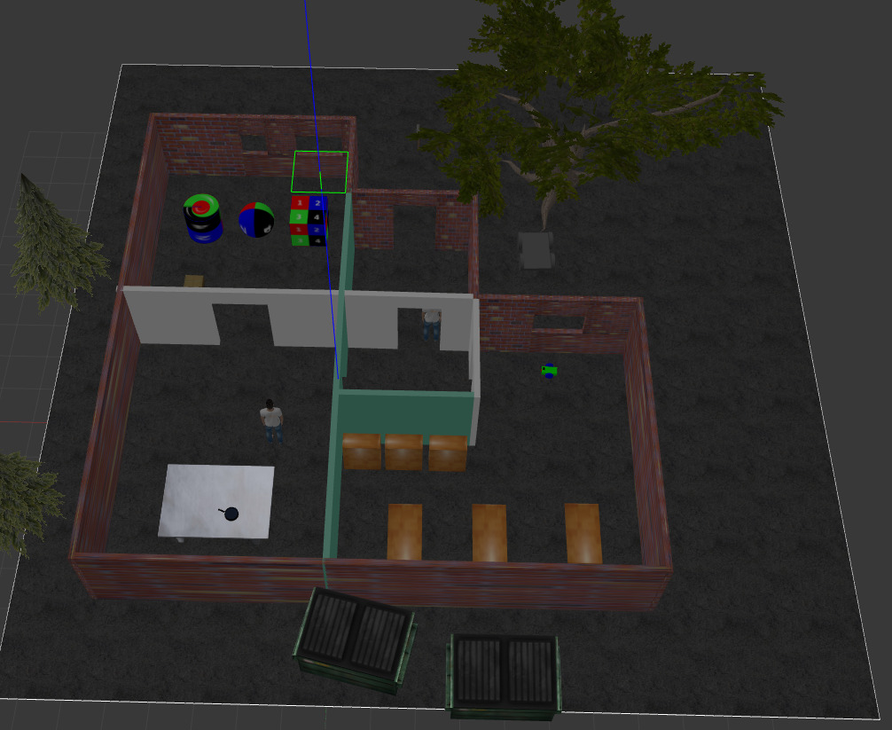
Our World

Slide 9
Service:
Service, which is defined by a pair of message: one for the request and one for the reply.
One time communication
A Clients sends a service and server sends back the response.

Slide 10
Scripts:
To run a script using rosrun the script has to be executable.
The script is made executable by using the command:
chmod +x

Slide 11
CODE IMPLEMENTATION

Slide 12
PROJECT SIMULATION

Slide 13
Commands to execute the simulation:
To open gazebo with the robot in it:
$ roslaunch my_robot world.launch
Then,to start the ball_chaser nodes in another terminal so that the robot can start following the white ball:
$ roslaunch ball_chaser ball_chaser.launch

Slide 14
SIMULATION IN GAZEBO:

Slide 15
THANK YOU

